Slide 1
Industrial Controls
Introduction

Slide 2
Industrial controls
What are they? Where are they found?
Protective Relays
Building Automation Controllers
Programmable Logic Controllers
Communications Processors
Smart Controls
Data Trend Recorders
Process Controllers
Human Machine Interfaces and Displays

Slide 3
How do we interact
Serial (EIA232 or EIA485) Communications
Direct device connection, minimal parameters
Interaction through PC via software platform
Moderate settings and logic
Front Panel or Human Machine Interface
Direct interaction with device itself
Buttons/Switches/Screens/Etc.
Basic settings and some logic
Ethernet (RJ45) Network Communications
Direct or Network connection
Interaction through PC via software platform
Advanced settings and logic

Slide 4
What makes an Industrial Control System?
Industrial Control Systems

Slide 5
What makes an Industrial Control System?
Trending
Metering
IED
Inputs
Industrial Control Systems
SCADA
RTU
Outputs
PLC
VFD
Communications Processor
RTD

Slide 6
What does an ics look like?
IED
Instrumentation
Data Concentrator
Trending
Human Machine Interface
RTU
Comm Proc
RTU
RTU
Instrumentation

Slide 7
Sel-351s Protection System
Relevant Software:
AcSELerator Quickset (SEL-5030)
TeraTerm Terminal Emulator
Settings and Configurations Methods:
Front Panel Control
Serial Communications
Ethernet Communications
Logic Capabilities:
Proprietary SELogic (3xx Series)
Primary Control Application:
Power Grid Protection
AC V/I Measurements
Digital Outputs

Slide 8
Sel-849 motor management relay
Relevant Software:
AcSELerator Quickset (SEL-5030)
TeraTerm Terminal Emulator
Settings and Configurations Methods:
External HMI (SEL-3421/-3422)
Serial Communications
Ethernet Communications
Logic Capabilities:
Proprietary SELogic
Primary Control Application:
Medium Voltage Motor Protection
AC V/I Measurements
Digital Outputs
Arc Flash Protection

Slide 9
Sel-35xx Real Time Automation controlLer
Relevant Software:
AcSELerator RTAC (SEL-5033)
Web Browser (Chrome/Firefox)
Settings and Configurations Methods:
Ethernet Communications
Logic Capabilities:
IEC 61131-3 Standard
Ladder Diagrams
Continuous Function Charts
Structured Text
Primary Control Application:
Communications Aggregation
Power System SCADA
Data Collection/Aggregation
Logic/Automation Controller

Slide 10
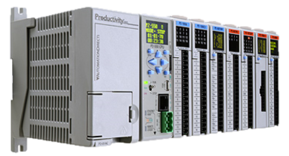
Productivity2000 Programmable logic controller
Relevant Software:
Productivity Suite
Settings and Configurations Methods:
Ethernet Communications
Logic Capabilities:
Ladder Diagrams
Primary Control Application:
Digital Inputs and Outputs
Data Collection/Aggregation
Logic/Automation Controller

Slide 11
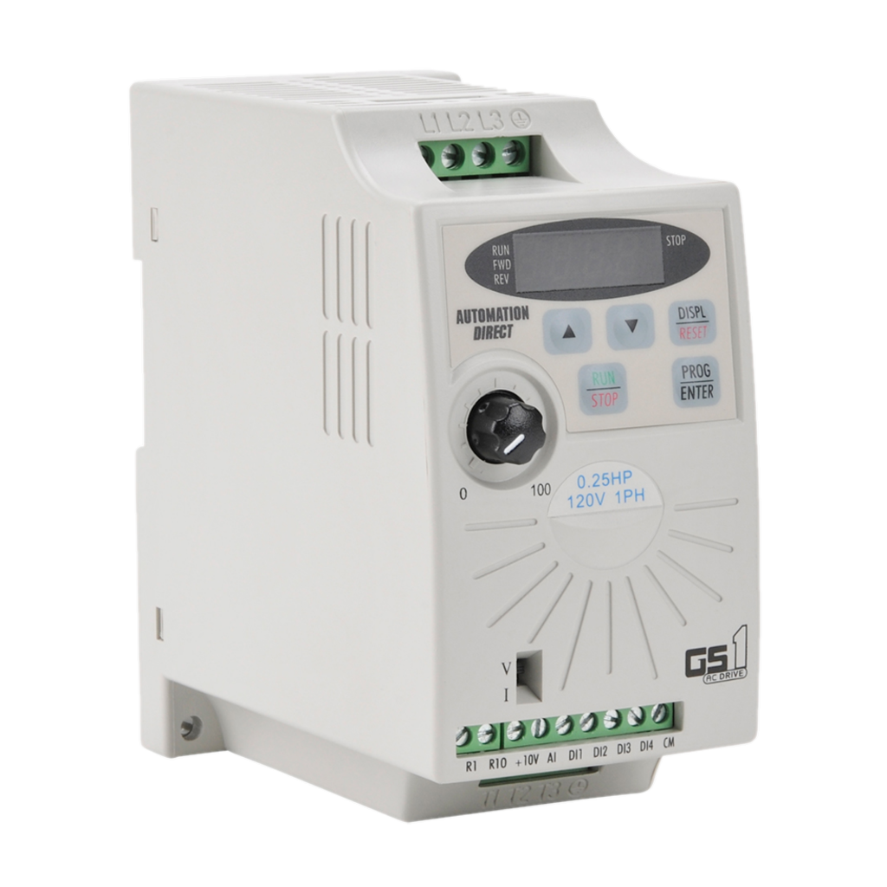
Gs1 variable frequency drive
Relevant Software:
None
Settings and Configurations Methods:
Front Panel Control
Serial Communications
Logic Capabilities:
None
Primary Control Application:
AC Motor Control
Speed Control
Simple Motor Protection

Slide 12
C-more Micro display
Relevant Software:
C-More Micro Programming Software
Settings and Configurations Methods:
Front Panel Control
Serial Communications
Logic Capabilities:
None
Primary Control Application:
Human Machine Interface
Control Interface
Monitoring Display

Slide 13
What does an ics look like?
IED
Instrumentation
Data Concentrator
Trending
Human Machine Interface
RTU
Comm Proc
RTU
RTU
Instrumentation

Slide 14

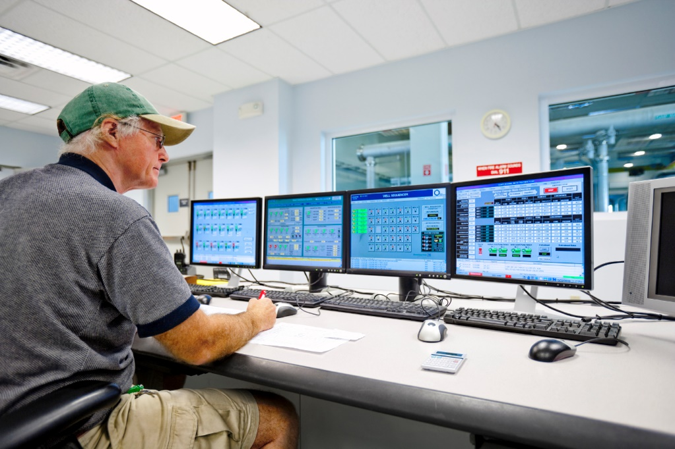
What does an ics look like?
Instrumentation
Instrumentation

Slide 15
Applications
ACSelerator Quickset
Teraterm terminal emulator
Acselerator rtac
Productivity suite
Acselerator diagram builder
C-more Micro software
Web-hosted configuration

Slide 16
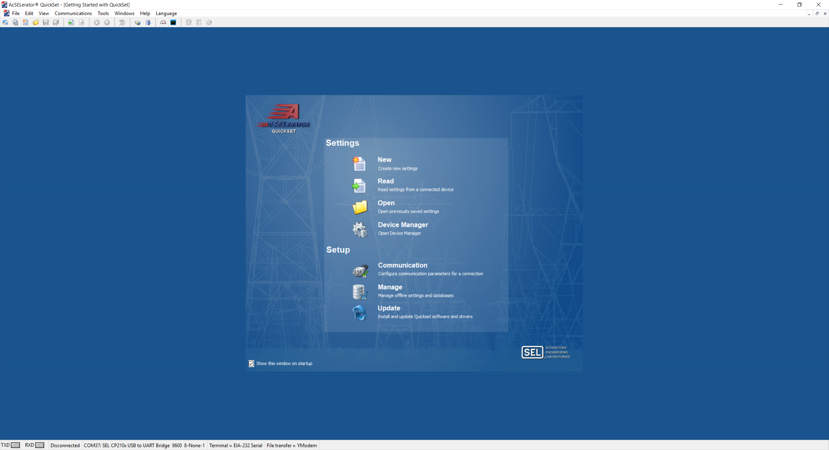

Acselerator quickset
Settings/programming software for Sel relays
Functionality:
Relay Settings Configuration
Terminal Emulator
Fleet Management
Firmware Upgrade Engine
Connection Capabilities:
Serial
Network
Modem

Slide 17
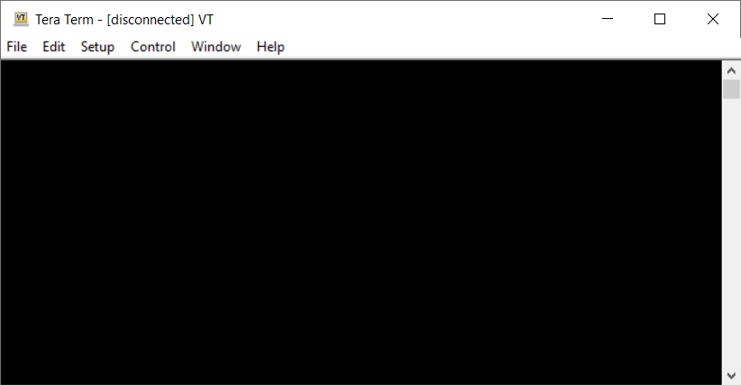
Teraterm terminal emulator
Terminal emulator for terminal interactions
Functionality:
Terminal Emulator
Relay Settings Configuration
Relay Metering Options
Firmware Upgrade Engine
Connection Capabilities:
Serial
Network

Slide 18
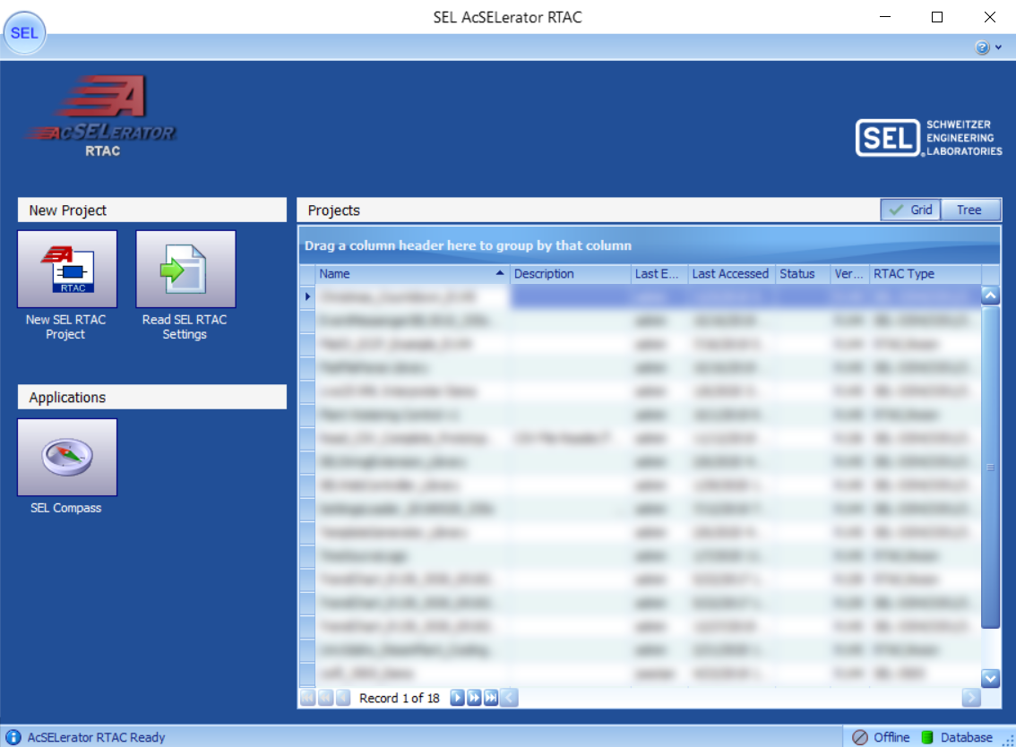
Acselerator rtac
Settings/programming software for Sel rtac family
Functionality:
RTAC Project Configuration
Live Data Veiwer
Programming Debugger (Breakpoints)
Logic Development Platform
Firmware Upgrade Engine
Connection Capabilities:
Network

Slide 19
Productivity suite
Settings/programming software for automation direct Productivity Plc’s
Functionality:
PLC Project Configuration
Live Data Viewer
Logic Development Platform
Firmware Upgrade Engine
Connection Capabilities:
Network

Slide 20
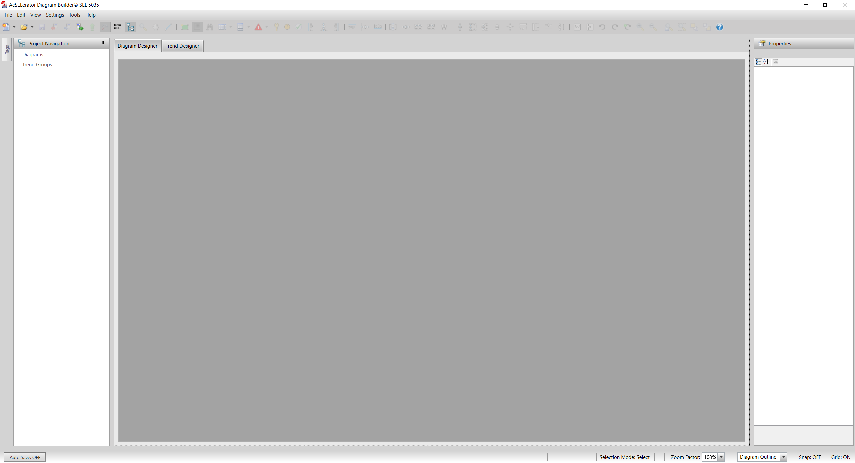
Acselerator diagram builder
HMI Development software for Sel rtac family
Functionality:
RTAC HMI Development
Control Development
Data Trending Development
Runtime Binary Upgrade Engine
Connection Capabilities:
Network

Slide 21
C-more micro software
HMI Development software for c-more micro family
Functionality:
RTAC HMI Development
Control Development
Data Trending Development
Runtime Binary Upgrade Engine
Connection Capabilities:
Network

Slide 22
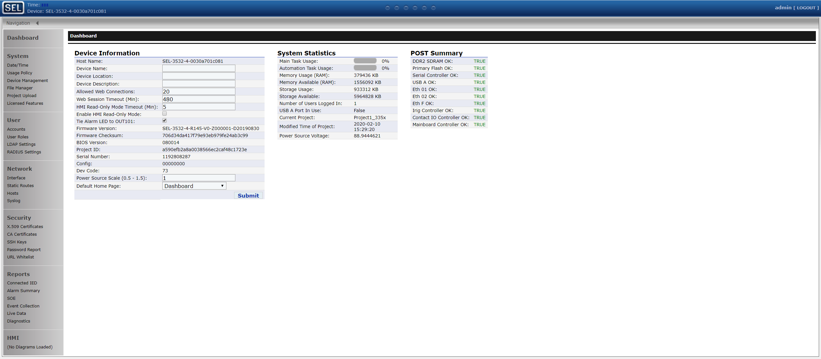
Web-hosted configuration
Settings and display of web-enabled devices
Functionality:
Web HMI Viewing
Network/Settings Control
Live Data View
Connection Capabilities:
Network

